Slide 1
Introduction to
Nailing your Thesis
Dirk Riehle, Univ. Erlangen
NYT A01
Licensed under CC BY 4.0 International

Slide 2
Course Learning Goals
Learning objectives
Understand science in general
Understand the scientific process, including
Research process and designs
Research methodologies and methods
Publications and the scientific community
Learn how to write a research paper (thesis)
Project objectives
Learn by performing a small research project

Slide 3
Definition of Science (Working Definition)
Science is the process of acquiring knowledge for correct prediction and reliable outcome. [DR]

Slide 4
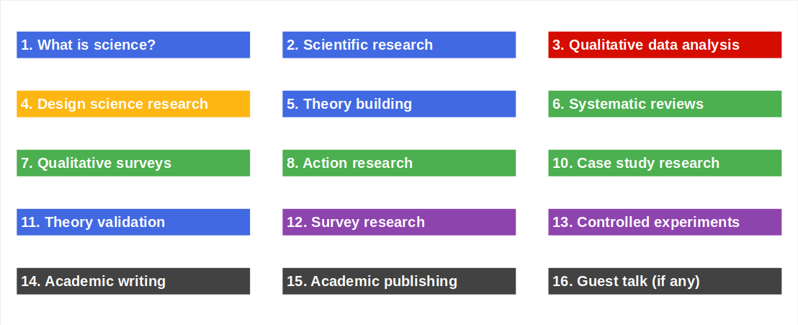
Course Content and Structure

Slide 5
Skills Required for Course
No particular requirements, but …
Strong conceptual and analytical thinking

Slide 6
Requirements for Final Theses
From the Bachelor-Prüfungsordnung Informatik (“writing about science”)
“Die schriftliche Bachelorarbeit soll ein wissenschaftliches Thema aus dem Bereich der Informatik behandeln.”
From the Master-Prüfungsordnung Informatik (“applying results of science”)
“Die Masterarbeit dient dazu, die selbständige Bearbeitung von wissenschaftlichen Aufgabenstellungen der Informatik nachzuweisen.”
From the Promotionsordnung Informatik (“creating scientific progress”)
“Die Dissertation soll die Fähigkeit des Bewerbers belegen, ingenieurwissenschaftliche Probleme selbständig und mit Erfolg zu bearbeiten und Wege zu ihrer Lösung zu finden.

Slide 7
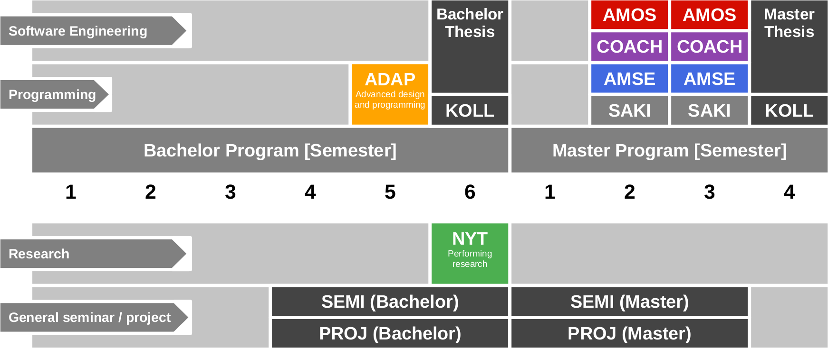
Course Position in Curriculum

Slide 8
OSS-NYT Courses and Modules
 |  | Courses (Lehrveranstaltungen)
 |  | NYT-VUE | NYT-PROJ | Total ECTS
Modules | NYT-VUE | x | – | 5 ECTS
 | NYT-PROJ | – | x | 5 ECTS
 | NYT-VUE+ PROJ | x | x | 10 ECTS
VUE = Lecture + exercise (Vorlesung + Übung)
PROJ = Project

Slide 9
NYT-VUE Grading [1]
Lecture-time contributions = 50% of total grade
Lecture content (4 SWS) = 60 / 150 = 40% (of semester contributions)
Graded using [0..10] each class session using class quizzes
Method exercises = 90 / 150 = 60% (of semester contributions)
Graded using [0..10] using tool and grading rubric
Oral exam = 50% of total grade
If both you and we agree on not having an oral exam, it can be dropped
If you insist on an oral exam, please tell us within two weeks after the last session
[1] See https://oss.cs.fau.de/teaching/course-resources/grading-schemes-and-scales/

Slide 10
Class Quizzes
Each class session starts with a class quiz
A quiz will test your understanding of last session’s topic
A quiz typically has 5 questions and will last 10 minutes
The overall quiz is graded using [0..10] scheme (10 points in total)
A class quiz will open precisely when class starts
The quiz is administered automatically
It is your job to have reliable Internet access etc.
There is no way to make up for a missed quiz

Slide 11
Grading Rubric for Homework Submissions
Categories | Points |  |  |  |  | Criteria
 | Disagree | Disagree some | Neutral | Agree some | Agree
Form (10%) | Does the deliverable meet formal requirements? |  |  |  |  | Does it meet length re- quirements, is it written in the right language, etc.?
Language (10%) | Is the language clear, concise, and helpful? |  |  |  |  | Are sentences complete, is the grammar correct, are statements coherent, etc.?
Structure (20-30%) | Does the deliverable have a clear logical structure? |  |  |  |  | Does it follow established or suggested structure? Is the argument logical?
Content (50-60%) | Does the discussion touch on all relevant issues? |  |  |  |  | As a reference, use your own deliverable as well as what you learned in class.

Slide 12
NYT-PROJ Grading
Six submissions and one presentation
Paper outline = 5%
Related work = 10%
Contributions 1 = 5%
Contributions 2 = 10%
Paper draft = 15%
Final paper = 40%
Final presentation = 15%

Slide 13
This Semester’s Projects
Let’s see…

Slide 14
Course Registration vs. Exam Registration
Step 1: Course registration (German: Kursanmeldung)
Students sign up through the course management system
You may or may not get in, various rules and regulations apply
The earlier you sign up, the more likely you are to get in
Step 2: Exam registration (German: Prüfungsanmeldung)
During the first weeks of the course, you can decide to drop out
Four weeks (or so) into the semester, you can register for the exam
After exam registration closes, your decision is binding

Slide 15
Receiving a Grade for the Course
If you want to receive a grade
You must register through your university’s exam registration system
Your degree program may have split the course into two (VL + UE)
Please check asap that the course is available in your degree program!
In case of problems, please see
https://oss.cs.fau.de/teaching/course-resources/course-registration/
Otherwise: No grade

Slide 16

No Oral or Written Exam [1] [2]
[1] If both you and we don’t want to
[2] You still have to register for the course

Slide 17
Course Language [1]
Class
Lecturer: English
Student: Choice of German or English
Exercise
Instructor: English
Homework: Choice of German or English
Project
English only
[1] See https://oss.cs.fau.de/2012/03/10/english-or-german-deutsch-oder-englisch/

Slide 18
Course Organization
Course organization
See https://nyt.uni1.de
Course schedule
See Schedule tab on Course organization doc
Project allocation
See Projects tab on Course organization doc

Slide 19
Work Rhythm
Lecture (class)
Review of last week (quiz)
Presentation of this week’s topic
Method exercise
Discussion of articles
Discussion of homework
Written homework
See Course organization doc
Self-organized

Slide 20
Course Communication
Announcements by email
Through course management system
Questions to teaching team
Please ask your question in the course forum
For private questions, use the teaching team email alias
Non-urgent questions will be answered in class

Slide 21
Thank you! Any questions?
dirk.riehle@fau.de – https://oss.cs.fau.de
dirk@riehle.org – https://dirkriehle.com – @dirkriehle

Slide 22
Legal Notices
License
Licensed under the CC BY 4.0 International license
Copyright
© 2012-2023 Dirk Riehle, some rights reserved

